Slide 1
How to Use SSH with VSCode
And Avoid the Hassle of Using FileZilla* with Omega
Jack
* You’ll still have to use FileZilla to transfer files between Omega and your device, but you won’t have to worry about constantly uploading files to Omega

Slide 2
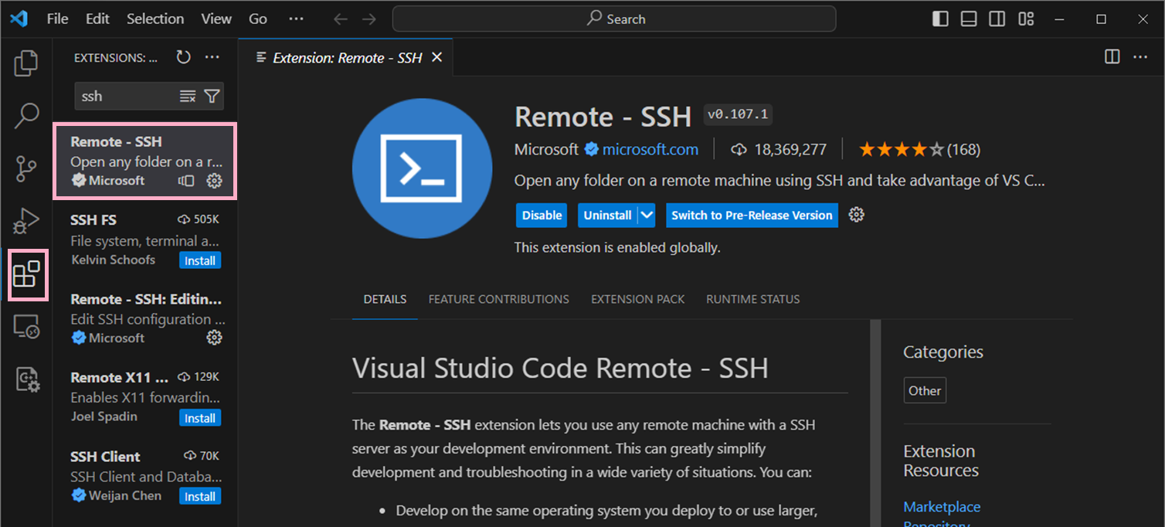
Download “Remote – SSH” Extension

Slide 3
Add a New Remote SSH
2. Make Sure “Remotes (Tunnels/SSH) Is Selected
3. Click the Add Button to Add a New Remote SSH
1. Go to the Remote Explorer Tab

Slide 4
Adding Remote SSH - Omega
Enter SSH Username [netID]@omega.uta.edu

Slide 5
Adding Remote SSH - Omega
Select the 1st configuration file

Slide 6
VM Setup – On Campus
If you are on campus, you would need PulseSecure activated on your VM
Without PulseSecure, you can’t connect to your VM
Follow the instructions here https://uta.service-now.com/selfservice?id=ss_kb_article&sys_id=KB0010762 for Linux
In other words, install PulseSecure ON YOUR VM

Slide 7
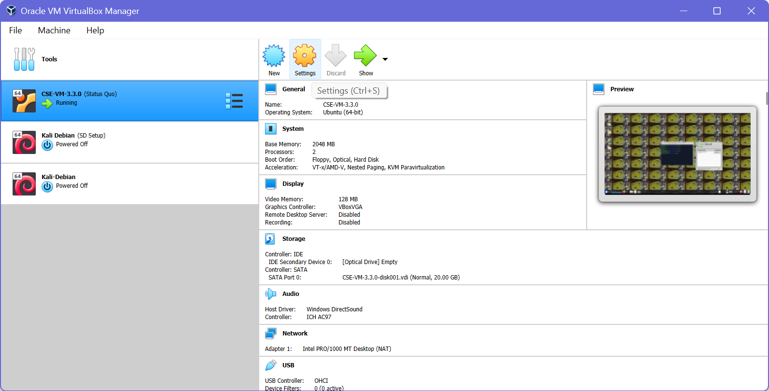
VM Setup – On Campus
In VirtualBox, go to Settings

Slide 8
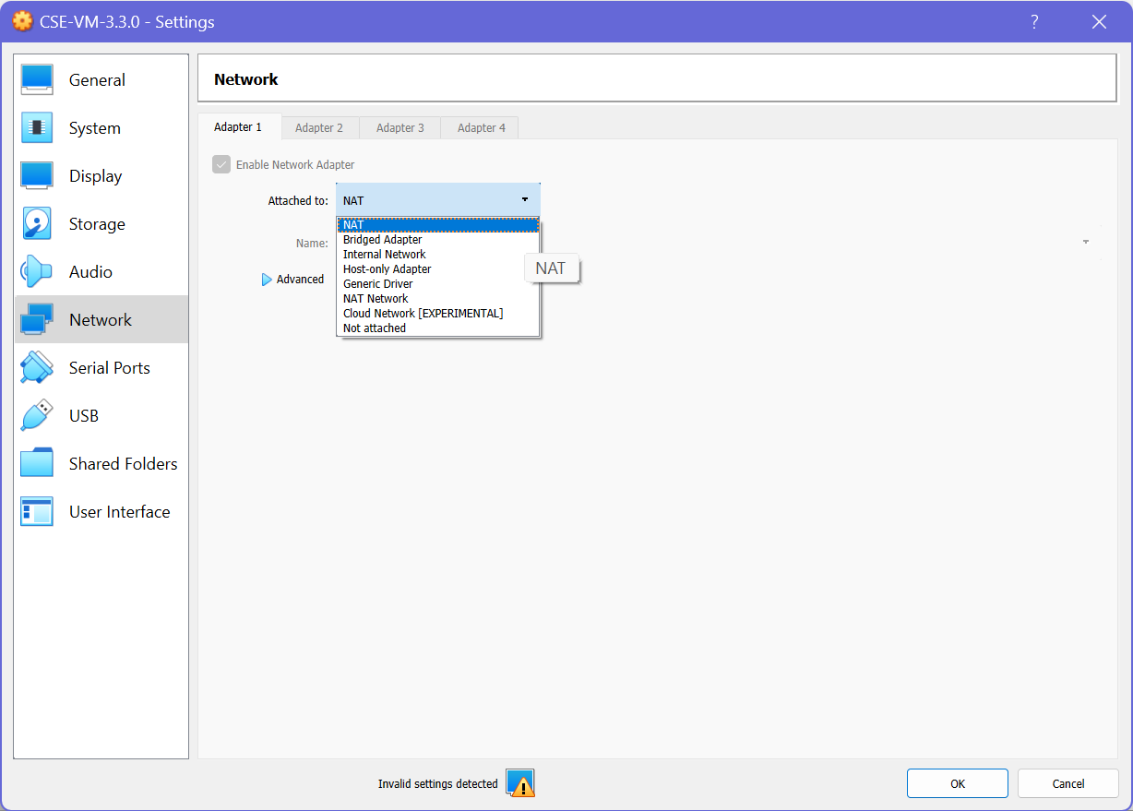
VM Setup – On Campus
In Settings, go to Network
Make sure you are attached to NAT

Slide 9
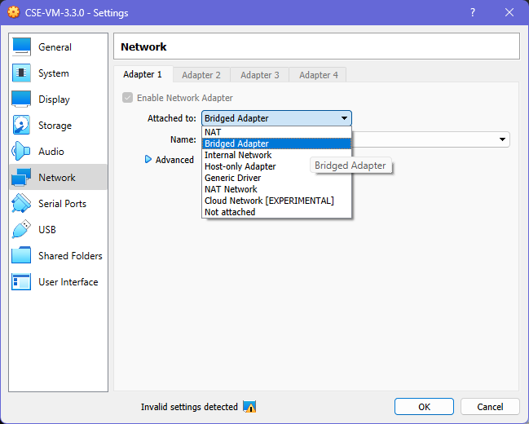
VM Setup – Off Campus
In Settings, go to Network
Make sure you are attached to Bridged Adapter

Slide 10
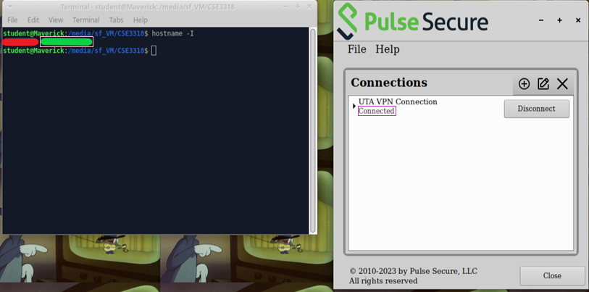
Adding Remote SSH – VM (On Campus)
In the VM, type hostname -I (capital i) to get the VM’s IP address
Use the 2nd IP address
NOTE: Make sure PulseSecure is active on both the VM and PM

Slide 11
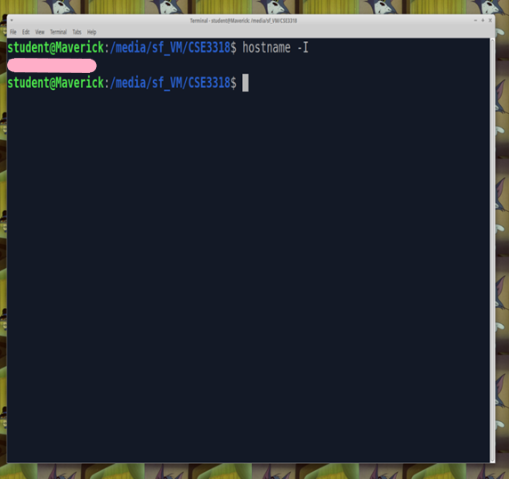
Adding Remote SSH – VM (Off Campus)
In the VM, type hostname -I (capital i) to get the VM’s IP address

Slide 12
Adding Remote SSH - VM
1. Repeat the Steps to Add a New Remote SSH
2. Enter this into the textfield: student@[VM IP Address]
Note: Make sure your VM is on; you cannot SSH into it if it is powered off

Slide 13
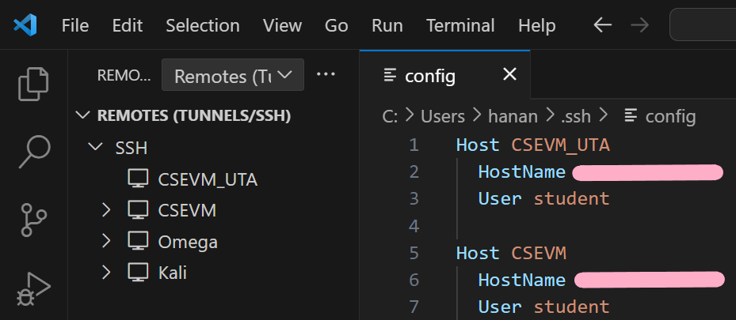
VM – Config File
In the VM, type hostname -I (capital i) to get the VM’s IP address

Slide 14
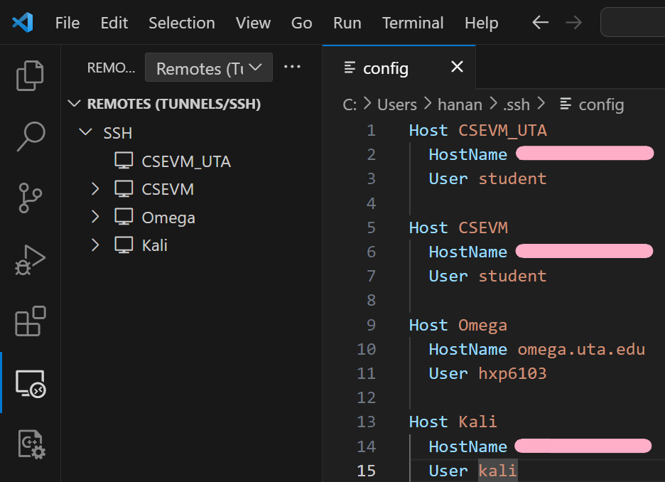
Checking the Configuration File
If you’re using the VM, you should have 2 users named student – especially if you want to use your VM on campus
This file contains all the machines you’ve allowed VSCode to SSH into

Slide 15
Checking the Configuration File
You can give your machine a nickname by changing the value of Host

Slide 16
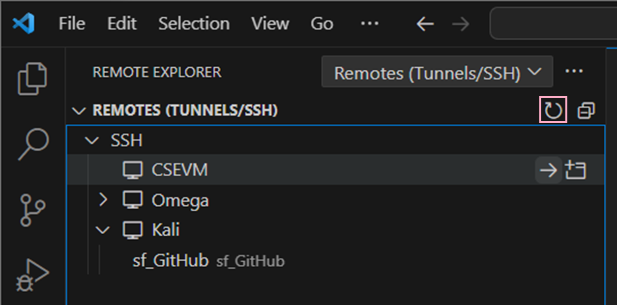
Checking the Configuration File
Press the refresh button to see the name change take effect

Slide 17
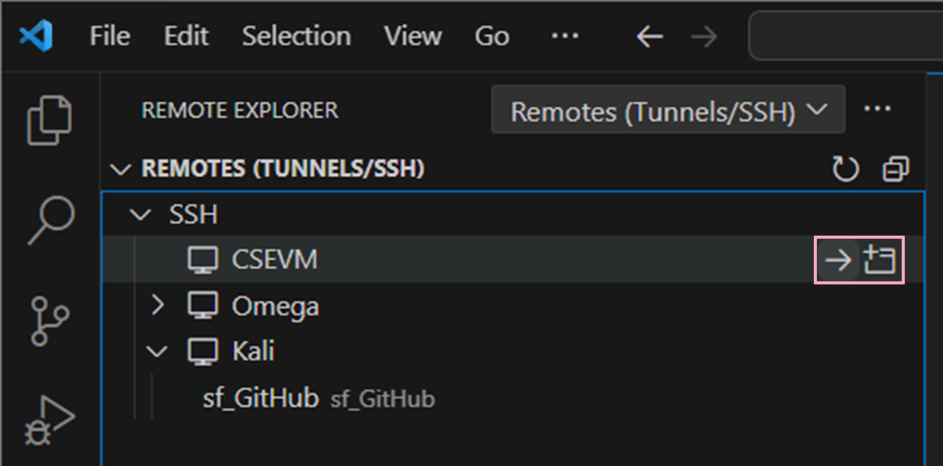
SSH’ing Through VSCode
1. Hover Over the Desired Machine
2. Select Any of the Two Buttons in the Pink Box

Slide 18
SSH’ing Through VSCode
Select Linux
Type in Your Password

Slide 19
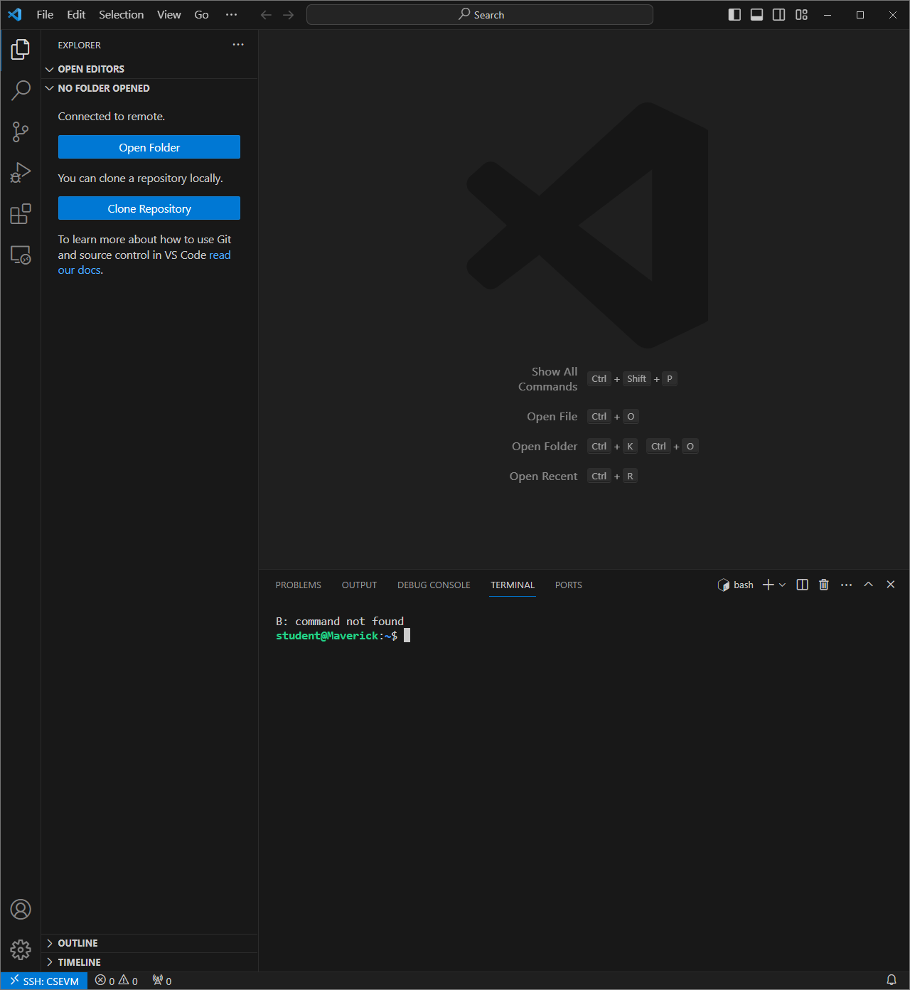
SSH’ing Through VSCode
Now You Have Successfully SSH’ed into Omega/VM
You can create files and run programs without needing to do any moving (i.e., FileZilla with Omega) because all the files will be created inside the machine
When SSH’ing into the VM, you will notice that the line
B: command not found keeps popping up. You can simply ignore this.

Slide 20
Accessing Folders - VM
If You Are SSH’ing Into the VM, Make Sure the Path Starts with
/media/sf_[Name of Shared Folder]

Slide 21
Accessing Folders - VM
Selecting Show Local Will Allow You to Open Files on Your Physical Machine
- This May Be Useful with the VM
- It Most Likely Won’t Be Useful When SSH’ing into Omega

Slide 22
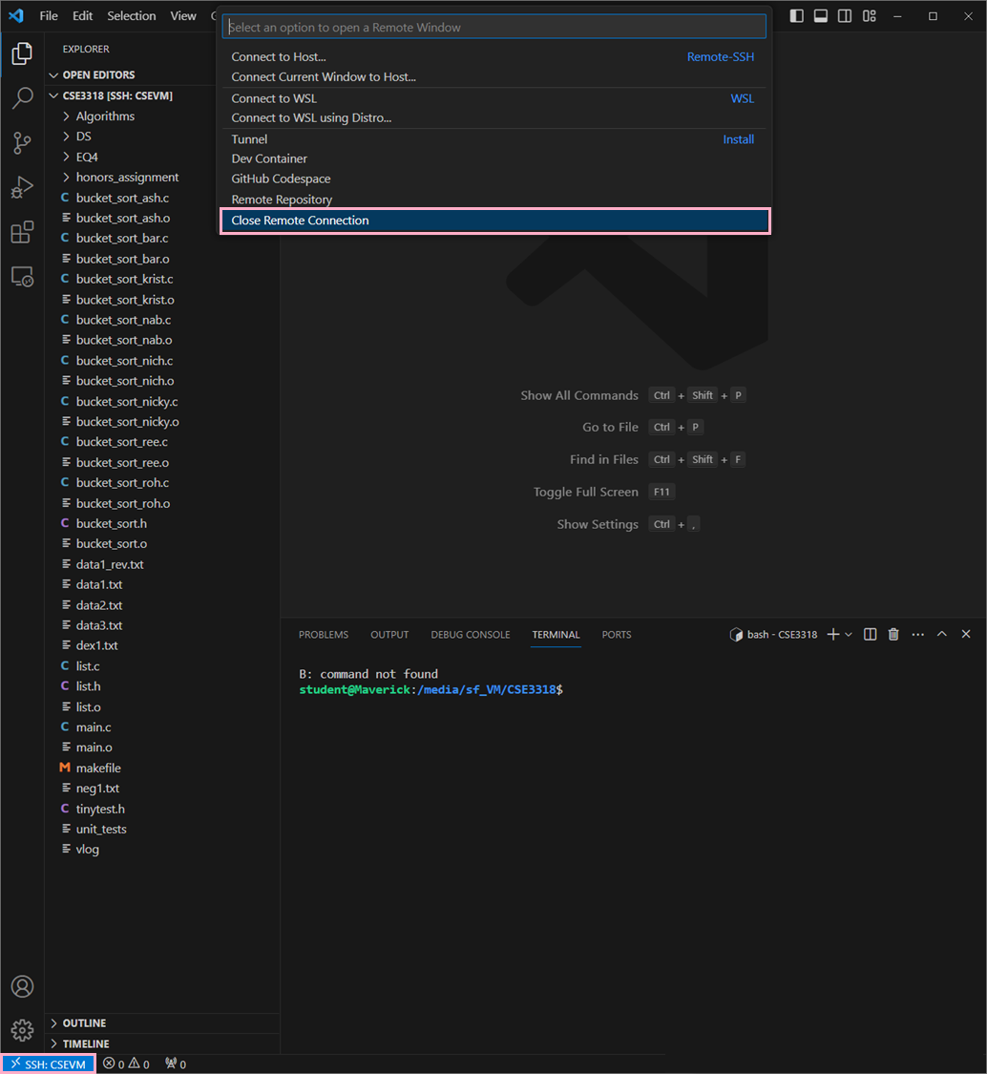
Closing a Remote Connection
2. Select Close Remote Connection
1. Click the Blue Button on the Bottom Right-Hand Corner

